Slide 1
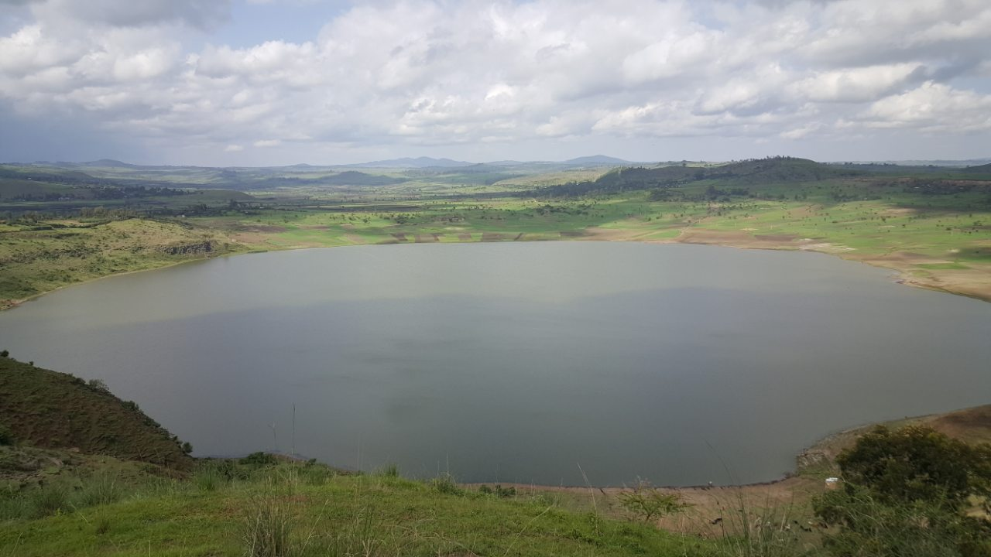
Hiwot sinka show launch
Addis ababa, Ethiopia

Slide 2
Shared vison
100 years from now in my community people will be living & expressing their greatness/potential through their lives. They are happier, peaceful, visionary, purposeful, confident, harmonies & joyful. I have created a media company which produce radio programs on self help topics. My team of editors, writers, guests & advisors all support & work towards this vision. The idea faces many obstacles because the listeners aren’t ready for such topics.

Slide 3
Current situation
Currently the media industry focus on entertainment & sports. Self development topics are not encouraged much because the listeners are not used to it and sponsors are not willing to pay. My shows face challenges from the radio stations & sponsors because they don’t see how much of a value they can be to the audience. The impact takes time to be noticed and so am thinking in 100 years from now such programs are sought after because everyone recognize it’s importance for society.

Slide 4
Current destination
If we continue with the trend we have now then the media will be feeding the minds of the next generation with information with no substantial value to their life. The numbing effect will further separate people form their inner voice & wisdom. Values & principle will be forgotten specially in cities due to the lack of appreciation for such ideas.

Slide 5
Program analysis
The difference is due to the lack of appreciation for information on developing the self. Working on ones mind set, attitude, belief system, talent , passion are some of the topics we explore on the show. Such topics are deemed a fad and not hard subjects which are tangible like math or physics.
People can’t see the benefits yet and prefer to tune in for music or the latest gossip or sport news which can entertain but have no real life value. The opportunities are limitless because more people are awakening to the idea and want more of it specially those tired of such programs.

Slide 6
Audience analysis
We focus on young professionals who are looking to upgrade the way they think act and live. They listen to the show to learn and apply in there own lives.
My typical audience is a women aged 25 with a degree, employed or with a business, in a relationship feeling like their is more to life and wants to live a more richer & meaningful life. She want to succeed in all aspects of life, physical mental, emotional & spiritual.

Slide 7
Communication Objective
The objective of the show is to create a platform for gratitude. We talk about the benefits of being thankful. Through interview of people who lead an inspiring life and listening to the stories of people who helped them get there the listeners get to view there own life in different light. After the show the listeners share there own story of gratitude so there is a spill over effect. The first person who believed in you, the person who financed your business venture, the person who helped you study, the person who loved you unconditionally all of this people are what our guests said thank you to. This stories are captivating and uplifting. As we get better at presenting this stories we can transcend the challenges of the newness of such ideas on the radio.

Slide 8
Key benefits statment
Key benefits and support points
The giveaway is the winning benefit because listeners like the gifts. It is exciting and they still connect with the show after. The feedback we got from all the prize winners is very encouraging and it made them continue listening to the show.
Key benefits,
Motivation- the show airs uplifting stories which is motivational
Participation- the audience can participate through phone, sms, social media & email
Giveaway – we give ebook, audio ebook, lunch tickets, mobile cards

Slide 9
Evaluation indicator
We evaluate the impact of the show through phone & email interview. After each show we call the listners who called us live and ask how that weeks show has been. We collect and summarize the feedback to inform the upcoming week Show.

Slide 10
Media strategy
The campaign is conducted to promote the upcoming show we are about to launch on radio.
I prefer greater intensity because I already have a listener base with a demographics of young professional who are looking for new tools to enhance their life. We want to create more value for our devoted listeners.
We are in the media business. Radio & Social media is our preferred medium to reach our listeners.
Our way of reaching the audience is a mix of sms Facebook and website , radio show, email & phone communication.
Our listeners call or text us first we reach back through their email & our website . The radio show connect us weekly as they call us and text us live.
seasons need to be considered when creating a show.
the show is for youth in Addis ababa . The radio station only reaches Addis and neighbouring cities.
We are using social media & website to promote so our costs are minimised

Slide 11
Advantage & disadvantages
Advantages | Disadvantages
Radio is popular. It reaches many parts of the country and the worldwide. | It lacks visual
Phone call creates intimacy | They may not want to talk
Sms allows on spot communication | We may not know the person writing it
Website allows content to be delivered at the leisure of the audience | Creating a content needs time

